Slide 1
Arrowhead Framework Demonstration videos
KUL 4.0 IIoT
Jan van Deventer

Slide 2
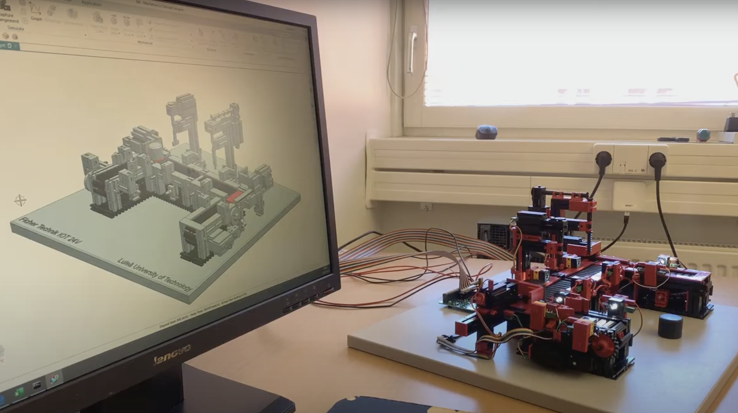
Fischertechnik indexed line with two machining stations and a digital twin over OPC-UA

Slide 3
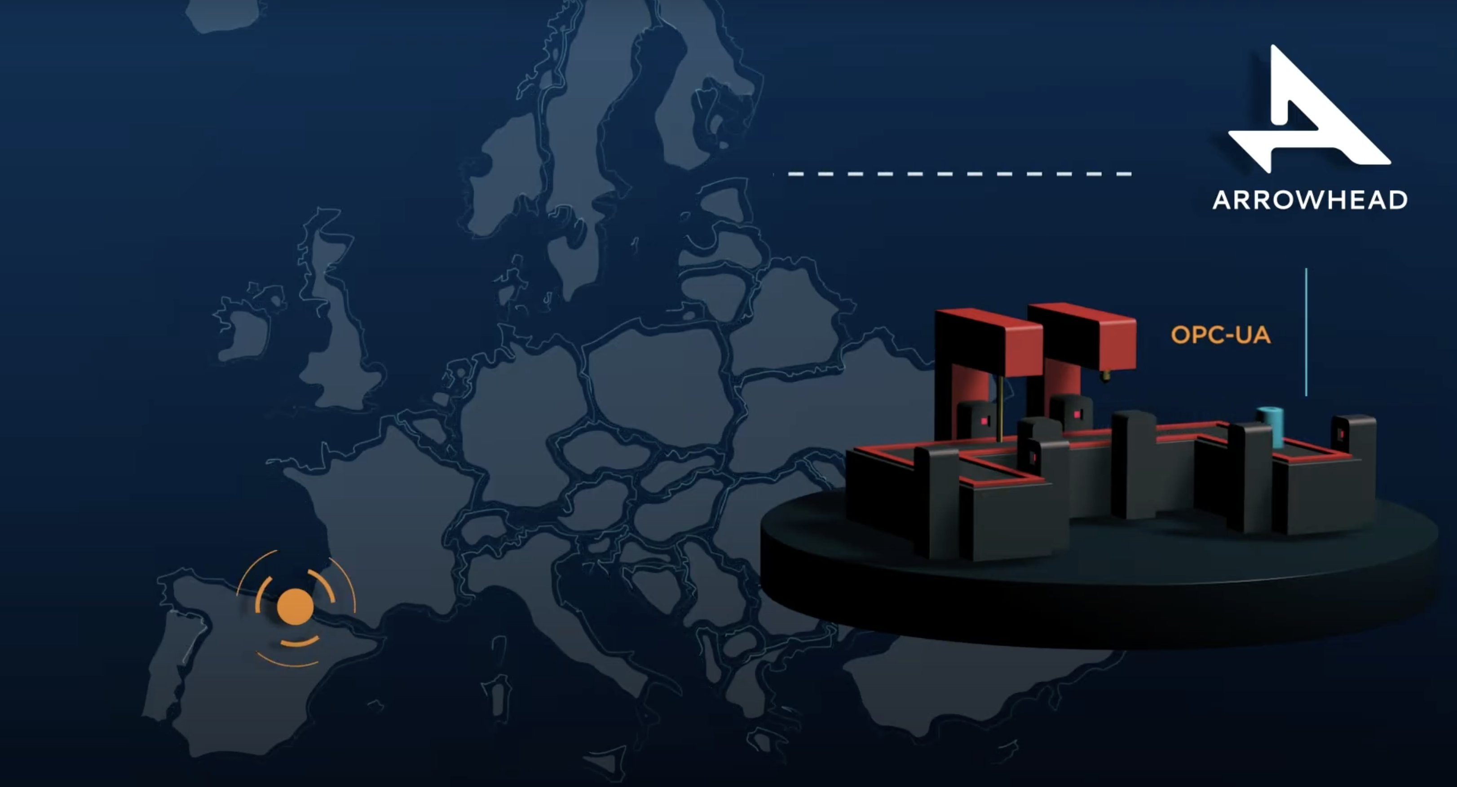
European Digital Manufacturing demo powered by Eclipse Arrowhead

Slide 4
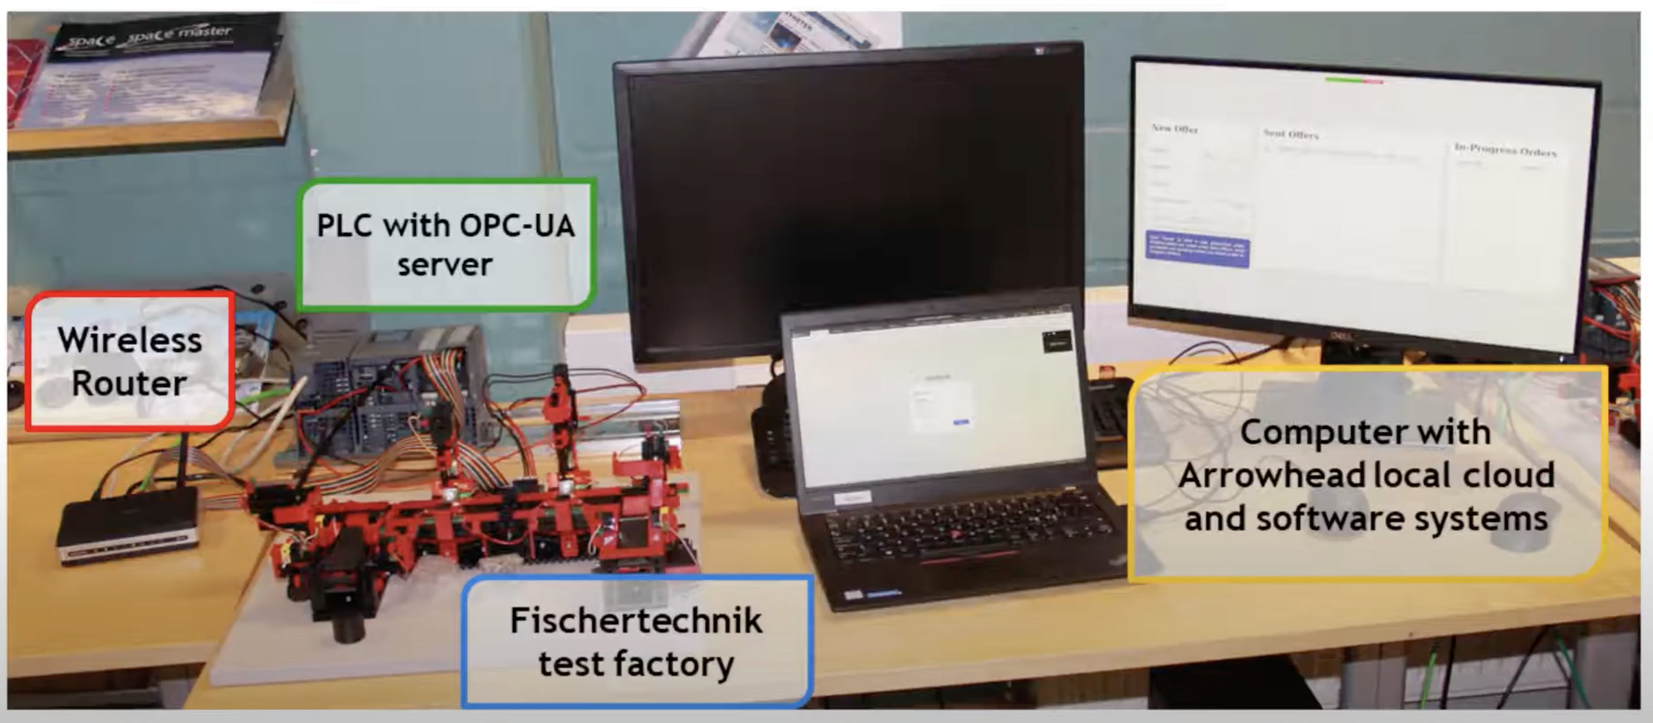
Contract aware production management
or Mass Customization

Slide 5
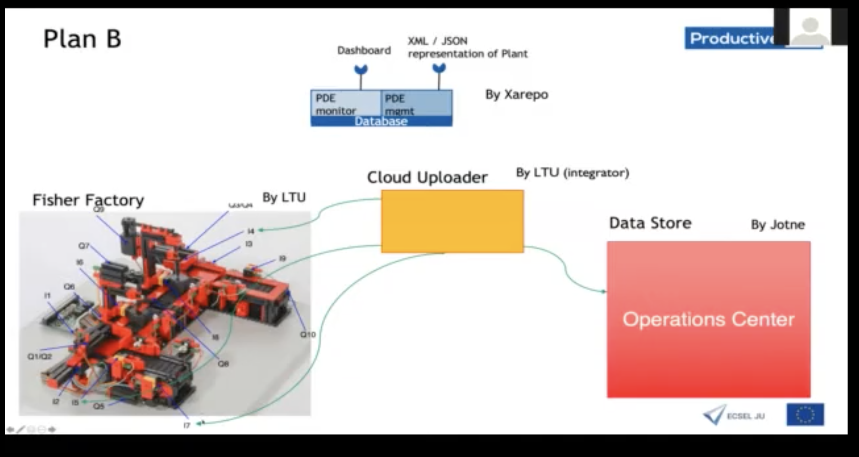
Late binding and Plant Description Engine in an Eclipse Arrowhead system of systems

Slide 6
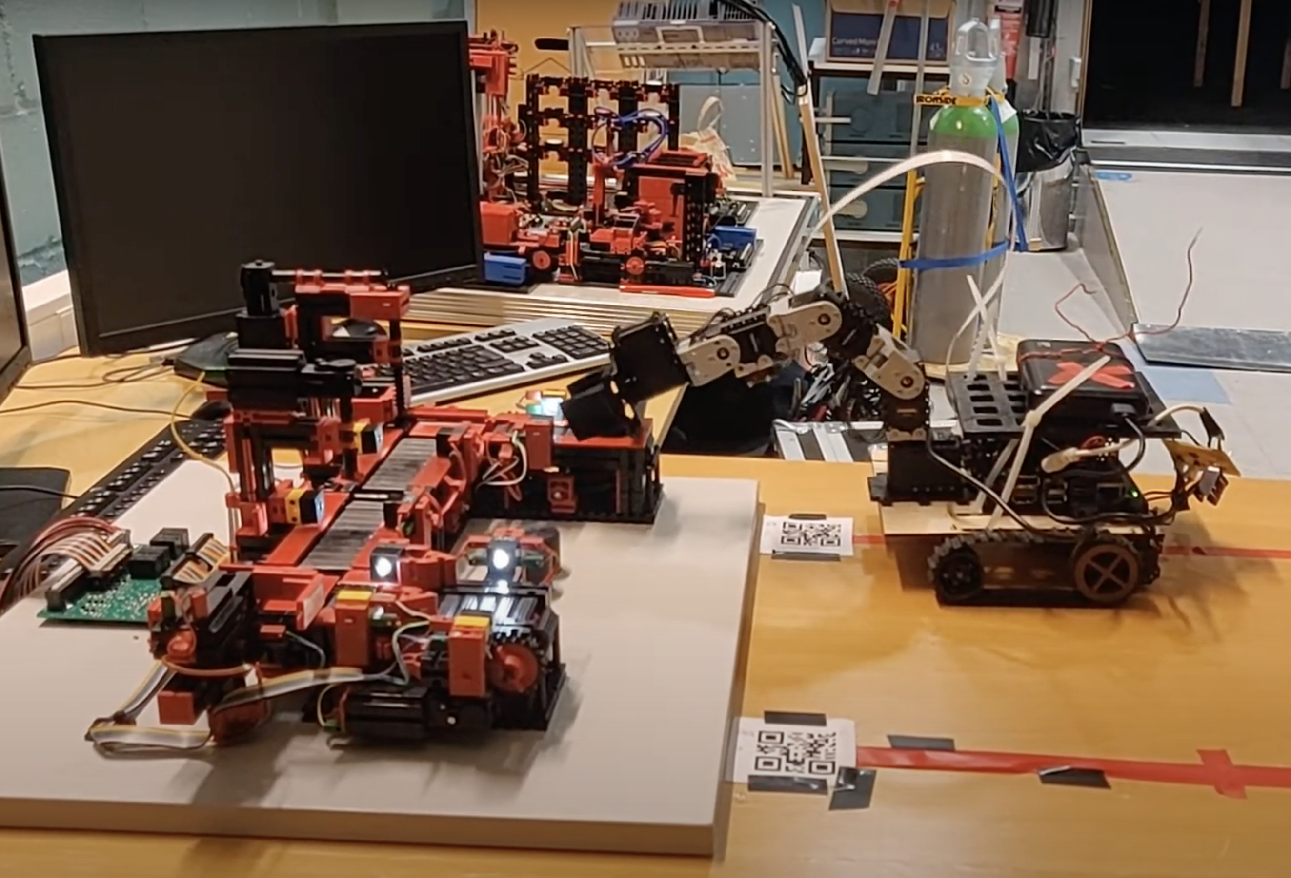
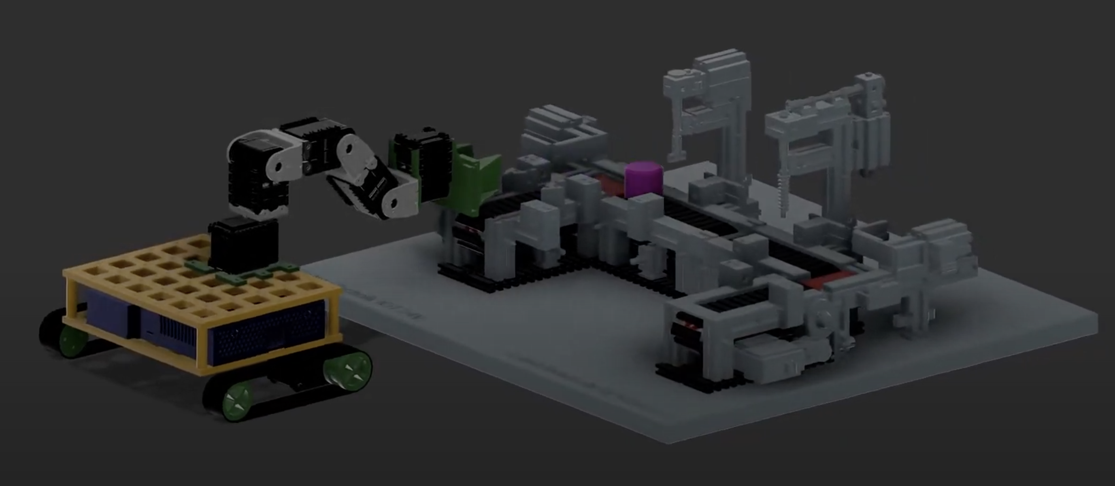
fichertechnik indexed line with robot with ROS

Slide 7
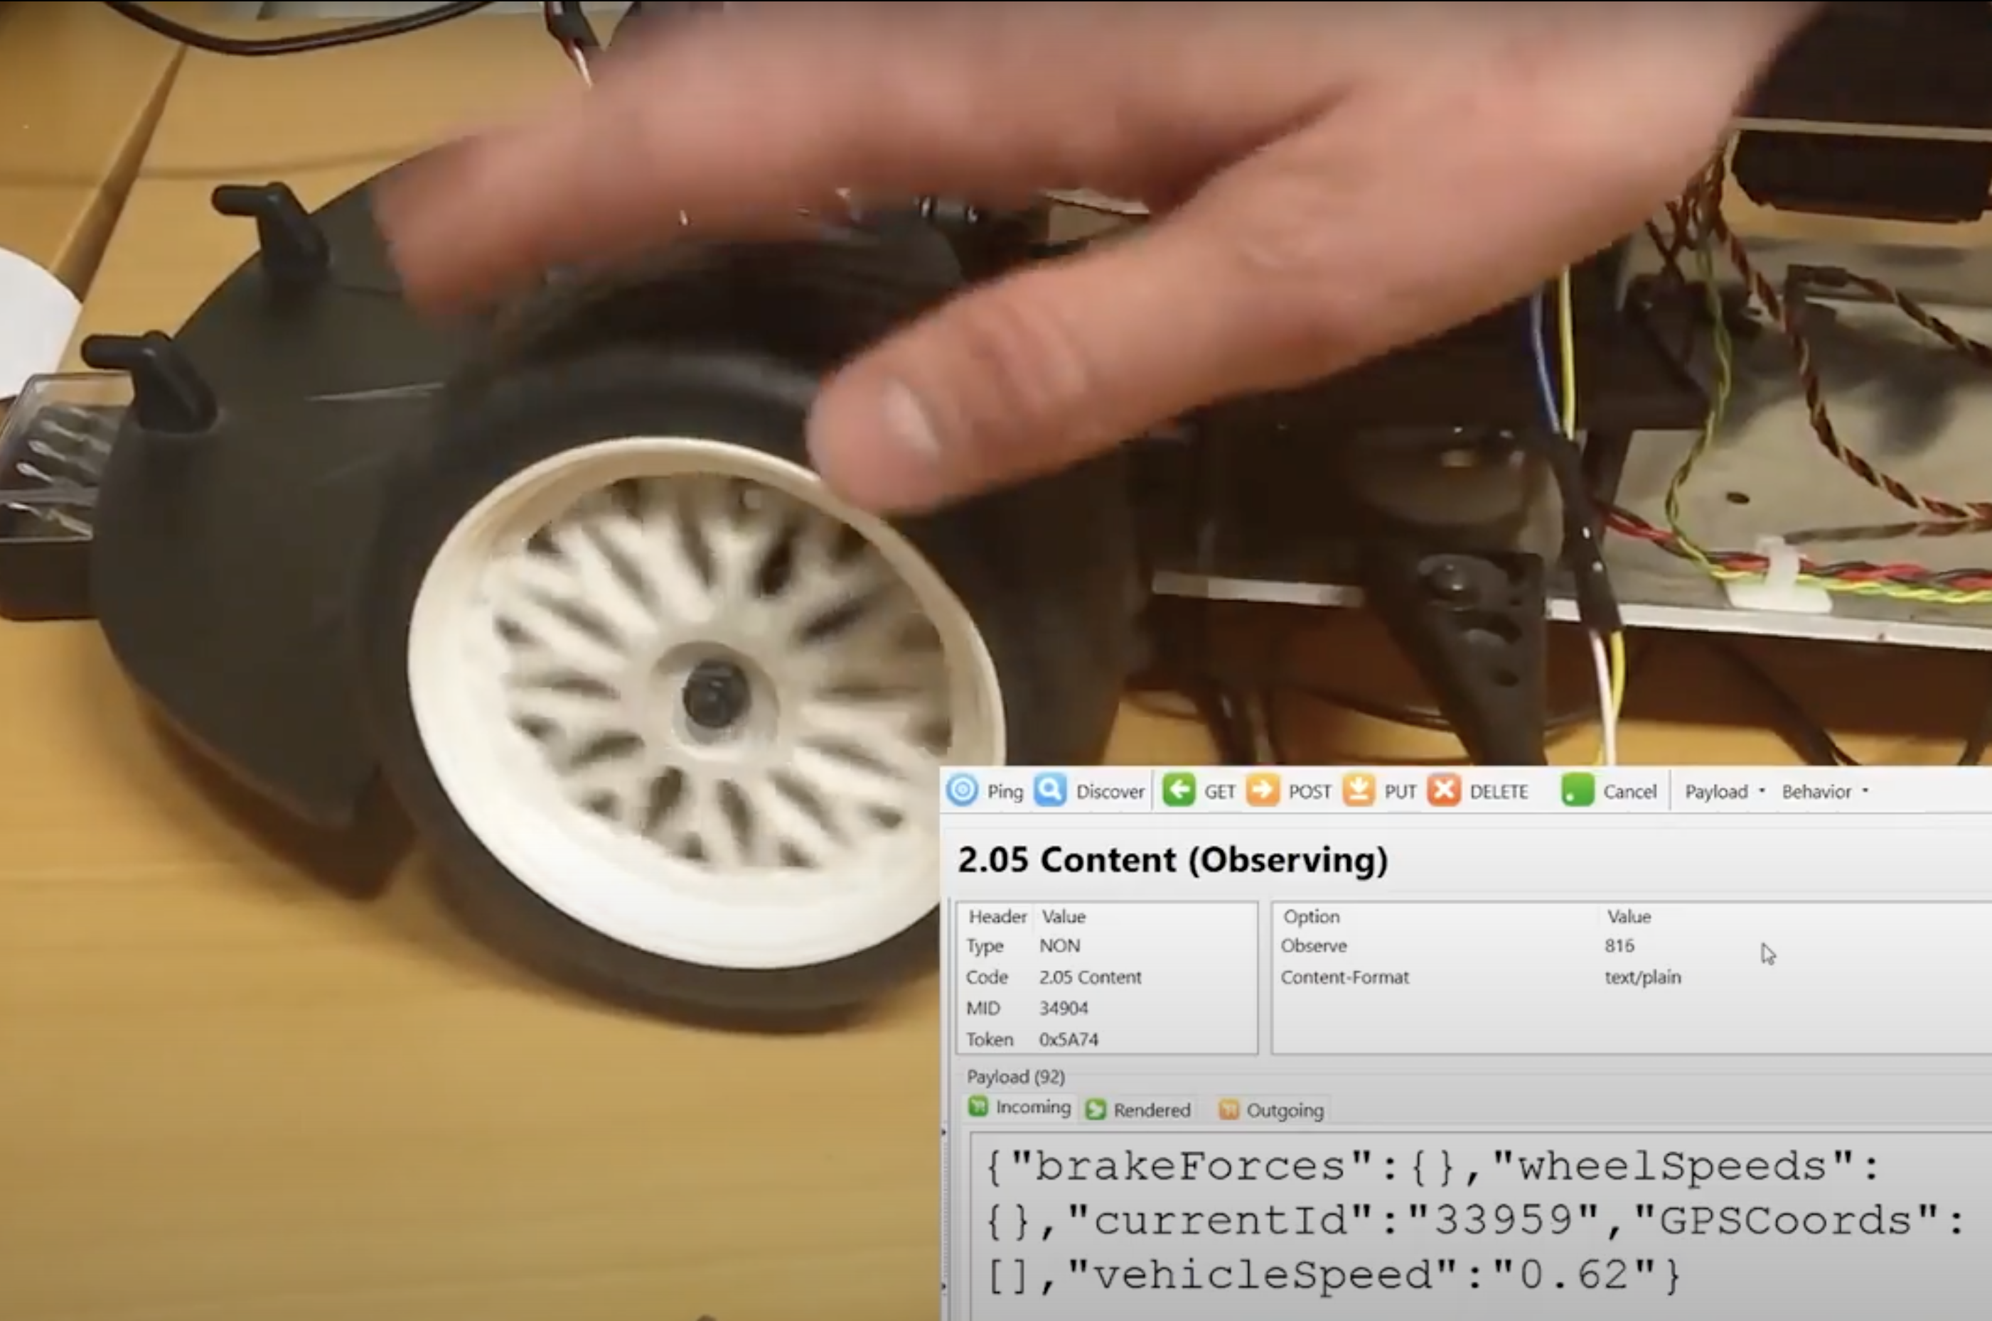
Model car (1/5 scales) as a cyber physical system

Slide 8
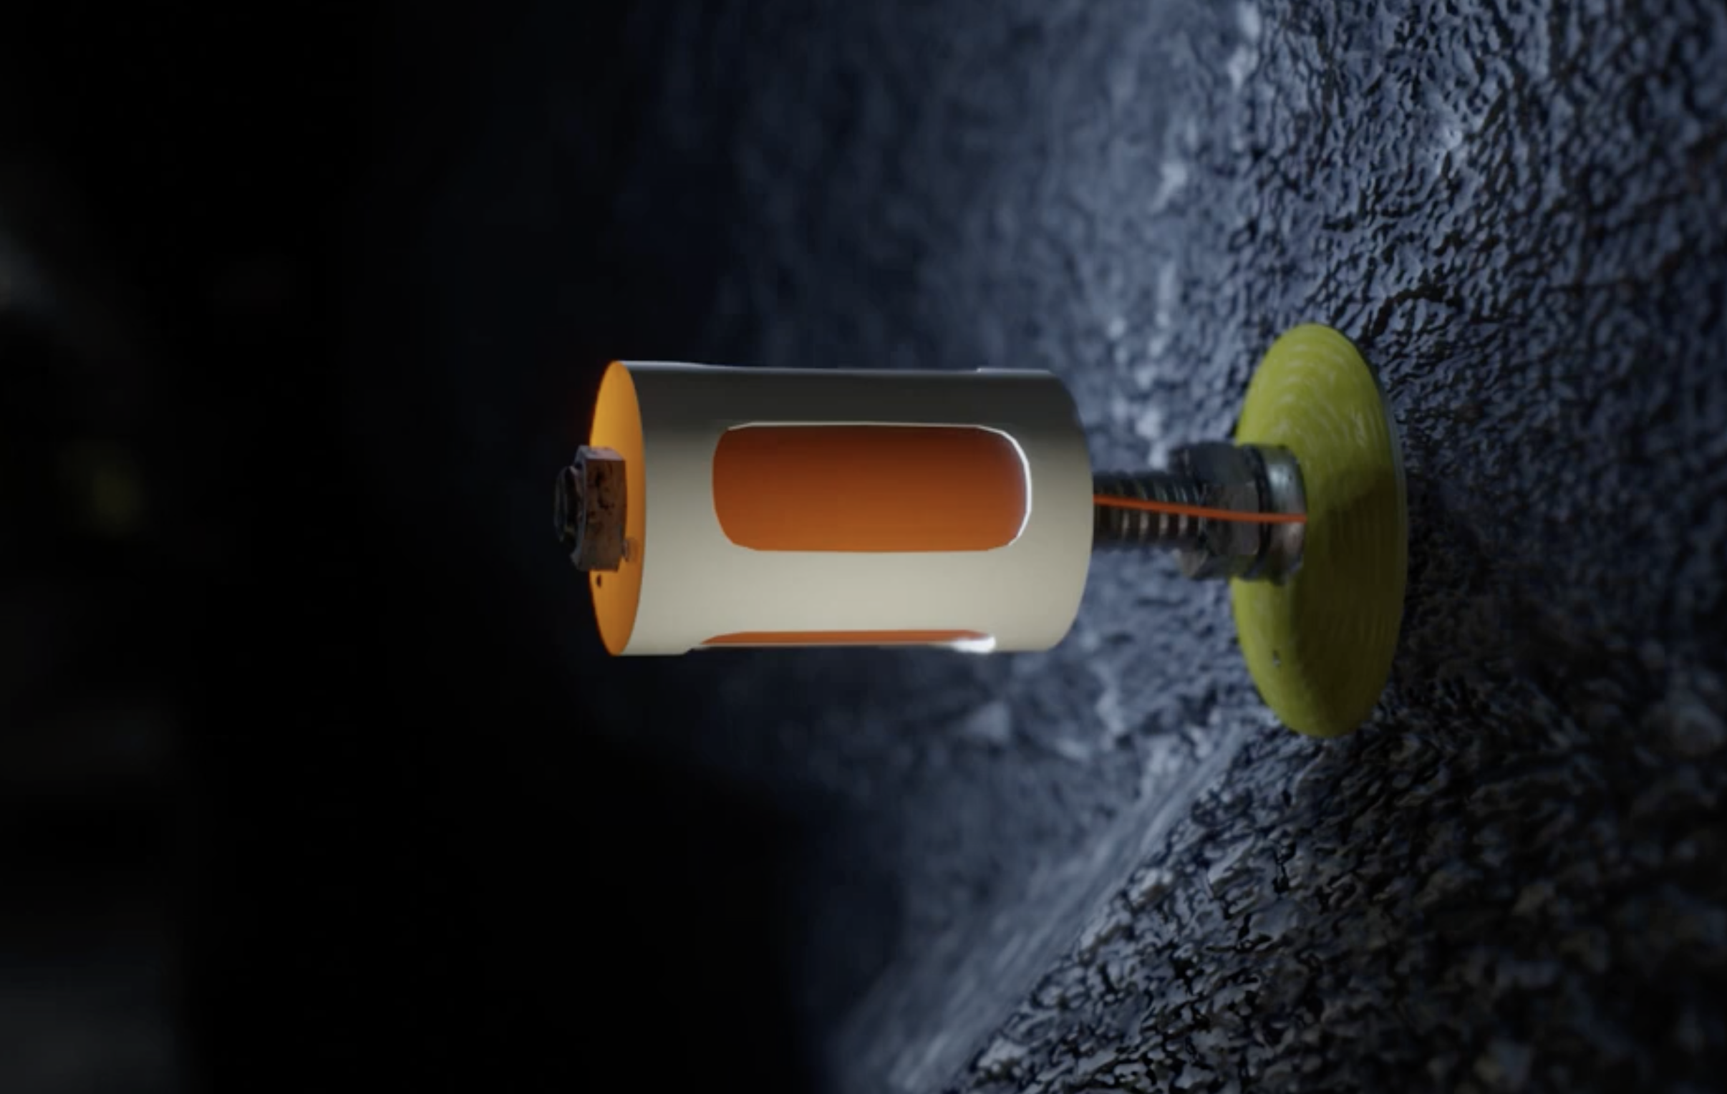
Arrowhead framework compliant rock-bolts in mines

Slide 9
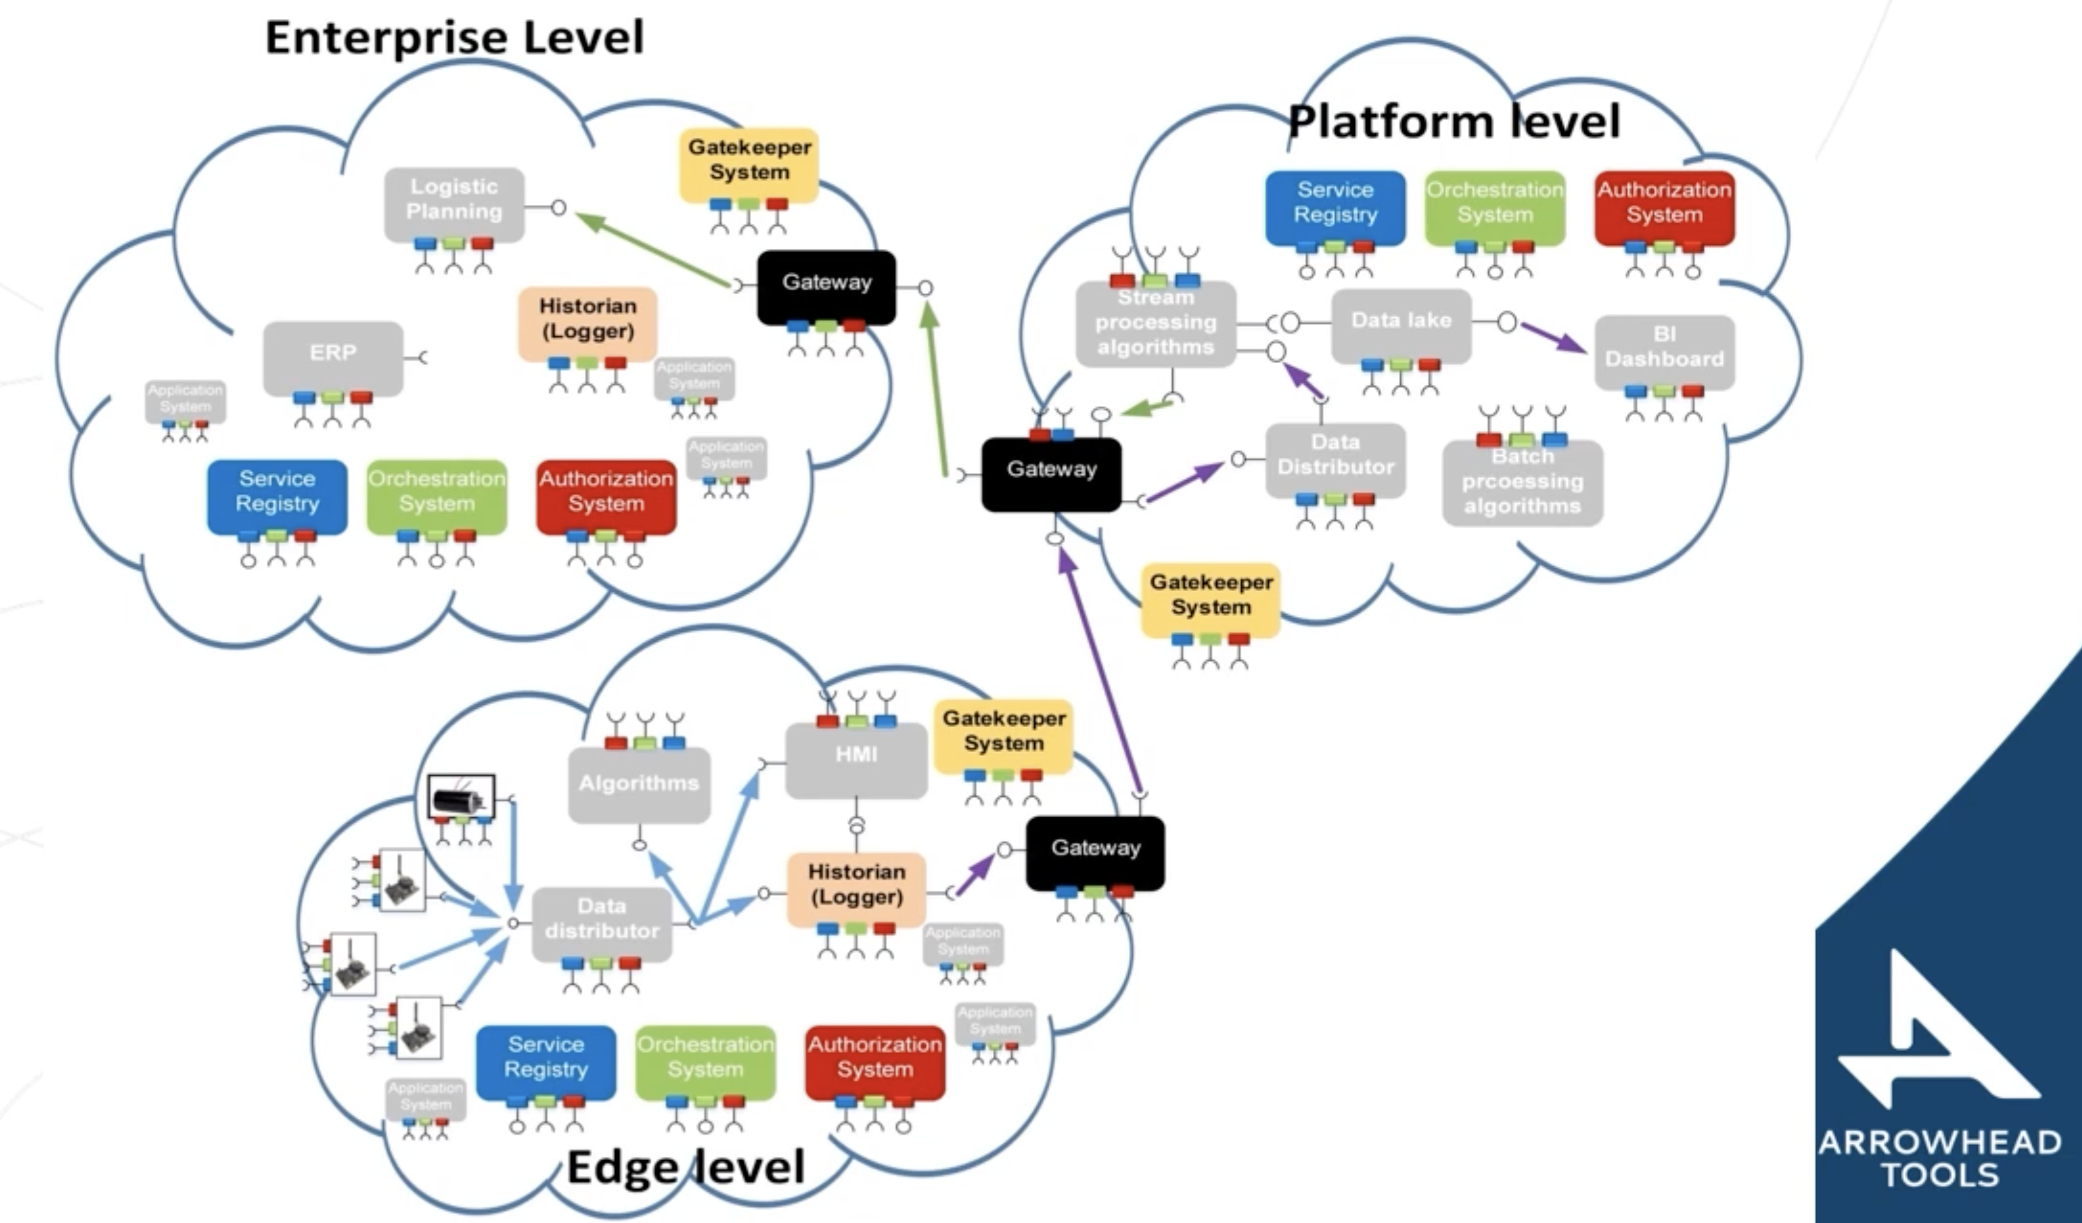
Eclipse Arrowhead Basic Principles

Slide 10
Synopsis
The Eclipse Arrowhead framework has been applied to several industrial IoT applications and is being commercially used.

